Slide 1
Visit of Smt. Ritu Pande
Director
Department of Heavy Industries on
June 14, 2016

Slide 2
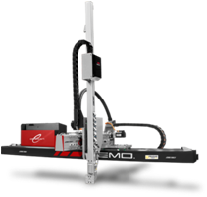
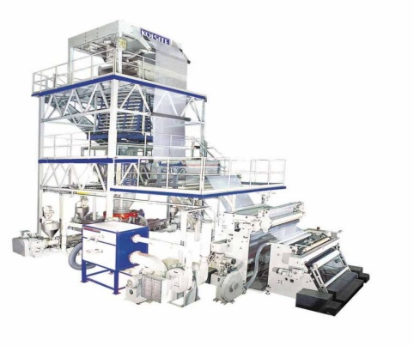
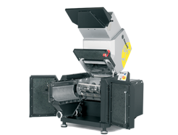
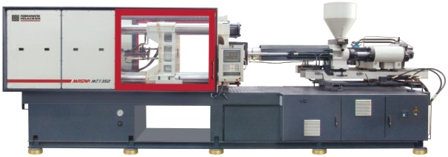
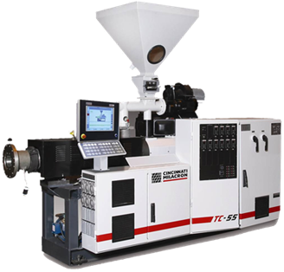
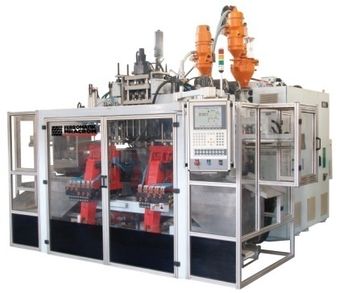
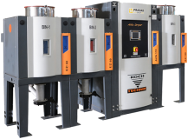
Type of Machinery & Auxiliary:
- Injection Moulding
- Extrusion
- Blow Moulding
- Roto Moulding
- Thermoforming
- Auxiliaries

Slide 3
Products Manufactured on Plastics Machinery:
Product Categories | Machine
Industrial Injection Moulding, Household Injection Moulding and Thermo-ware/ Moulded luggage, Houseware | Injection Moulding
Films & Sheets, Fibre & Filament Pipes, Conduits & profiles, Miscellaneous application | Extrusion
Bottles, Containers, & Toys | Blow Moulding
Large circular tanks such as water tank | Roto Moulding
Plastics Processing Machine Auxiliaries are integral and important segment. They improve efficiency and productivity by way of either supporting machine’s system or process automation

Slide 4
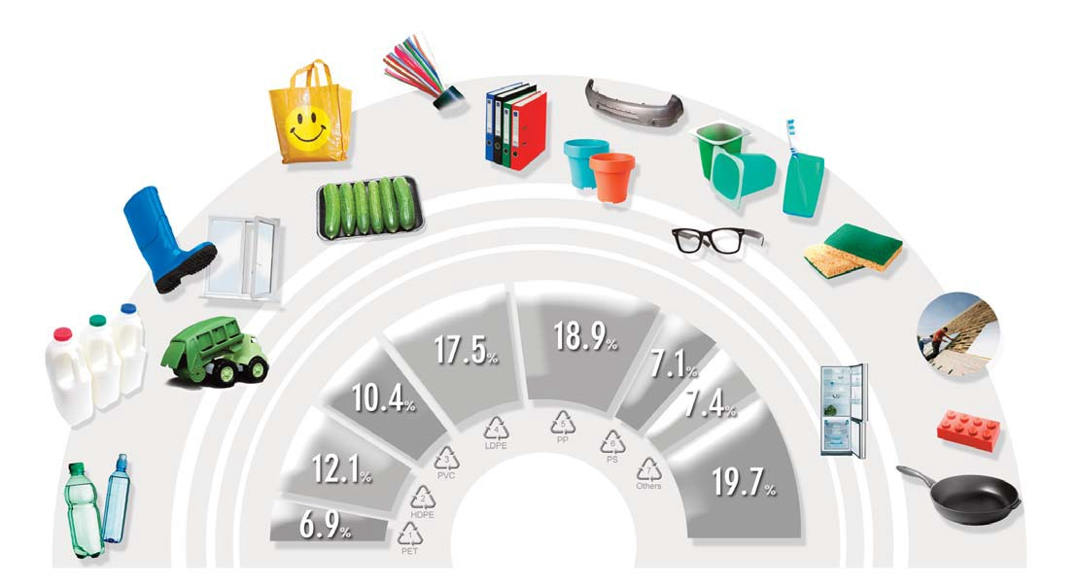
Different Plastics for different needs
PE-LLD wire cables
PP car bumpers
Most yoghurt pots are made of PS
PE-LD reusable bags
Film for food packaging
Office/school PP folders
PS plastic cups
PVC boots
PVC window frames
PP flowerpot
PUR sponges
PUR
insulation panels
PE-LD, PE-LLD
PP
PE-HD
milk bottles
PS glasses frames
PS, PS-E
PUR
Polycarbonate fridge trays
PVC
PE-HD toys
PE-HD
ABS bricks
Others
PET
PET bottles
PTFE (Teflon coated) pans
European plastics demand* by polymer type 2013
Source: PlasticsEurope (PEMRG) / Consultic / ECEBD
* EU-27+NO/CH

Slide 5
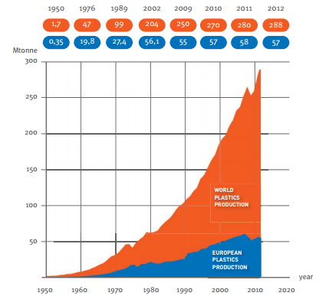
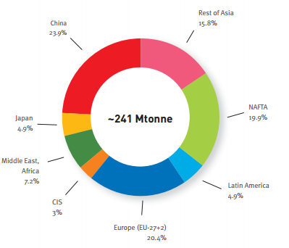
Plastics Machinery Global Growth :
Plastics Machinery is globally growing at double the rate of GDP
World Plastics Production
2012 World Plastics Material Production
288 Mtonne

Slide 6
Plastics Machinery Global Growth :
TOP 5 in World Production for Core Machinery
Year | World Production * Million Euro | Share of Particular Countries (%)
 |  | China | Germany | Italy | USA | Japan
2010 | 23,704 | 28.9 | 20.7 | 9.5 | 5.4 | 5.4
2011 | 28,462 | 30.2 | 21.8 | 8.7 | 6.5 | 5.5
2012 | 29,867 | 28.8 | 21.9 | 8.3 | 6.4 | 6.0
2013 | 30,802 | 30.2 | 22.1 | 8.1 | 7.1 | 4.4
2014 | 32,536 | 33.4 | 20.5 | 7.8 | 7.1 | 4.2
CAGR | 8.2%
* Estimate
Plastics Machinery Growth is more than GDP growth of these countries

Slide 7
10 Plastics Facts:
Plastics allow us to do more with less. Plastic is a lightweight and versatile material. It takes just a little bit of plastic to do a lot.
Plastics make a significant contribution to sustainable development. When evaluating the contribution plastics make to sustainable development, consider their impact on sustainability from a social, economic and environmental perspective.
Plastics account for a very small percentage of the world's natural gas and oil. Just think about it. Only four percent of the world’s oil reserve is used to make plastics.
Plastics reduce our consumption of oil. Estimates suggest that the 100 kg of plastic material used in modern cars replace between 200 and 300 kg of other materials.
Plastics are valuable even at the end of their lifecycle. After fulfilling the useful purpose that they were designed for, plastics can be recycled or reused as an alternative fuel.

Slide 8
10 Plastics Facts:
Plastics are essential to renewable energy technologies. Much of today’s focus on renewable energy technologies would not be possible without the use of plastics.
Plastics help preserve our precious resources. Over one billion people in the world lack access to safe water. Plastics can preserve and distribute water economically, reliably and safely.
Plastics are technological champions. From the thin sutures used in medical applications to the strong, resilient panels used in the aerospace industry, plastics are capable of taking on many forms and characteristics.
Plastics help reduce. Without plastics packaging, the weight of packaging would increase four-fold, production costs and energy consumption would double and waste volume would increase by 150 percent.
Plastics help keep us safe. Plastics protect us in many different areas of our lives.

Slide 9
Plastics Processing Machinery Credentials
Plastics Machinery Market is Approx Rs. 3,600 Crores. Domestic production is Approx Rs. 2,500 Crores
15 manufacturers in organized sector. Approx 200+ manufacturers in small & medium sector. Sector employs approx 1.20 Lakh (Direct + Indirect) people
Plastics machinery sector has potential to become significant part of our manufacturing economy as in industrialized countries – Germany, Italy, France, USA, Canada, Japan, China, Taiwan and South Korea
Machinery produced in India are of current technologies of global leading brands, hence holds high potential for the sector to be a global player
Plastics machineries are exported to Africa, Middle East, South East Asia, North & South America and Russia. Exports value Approx Rs. 600 Crores

Slide 10
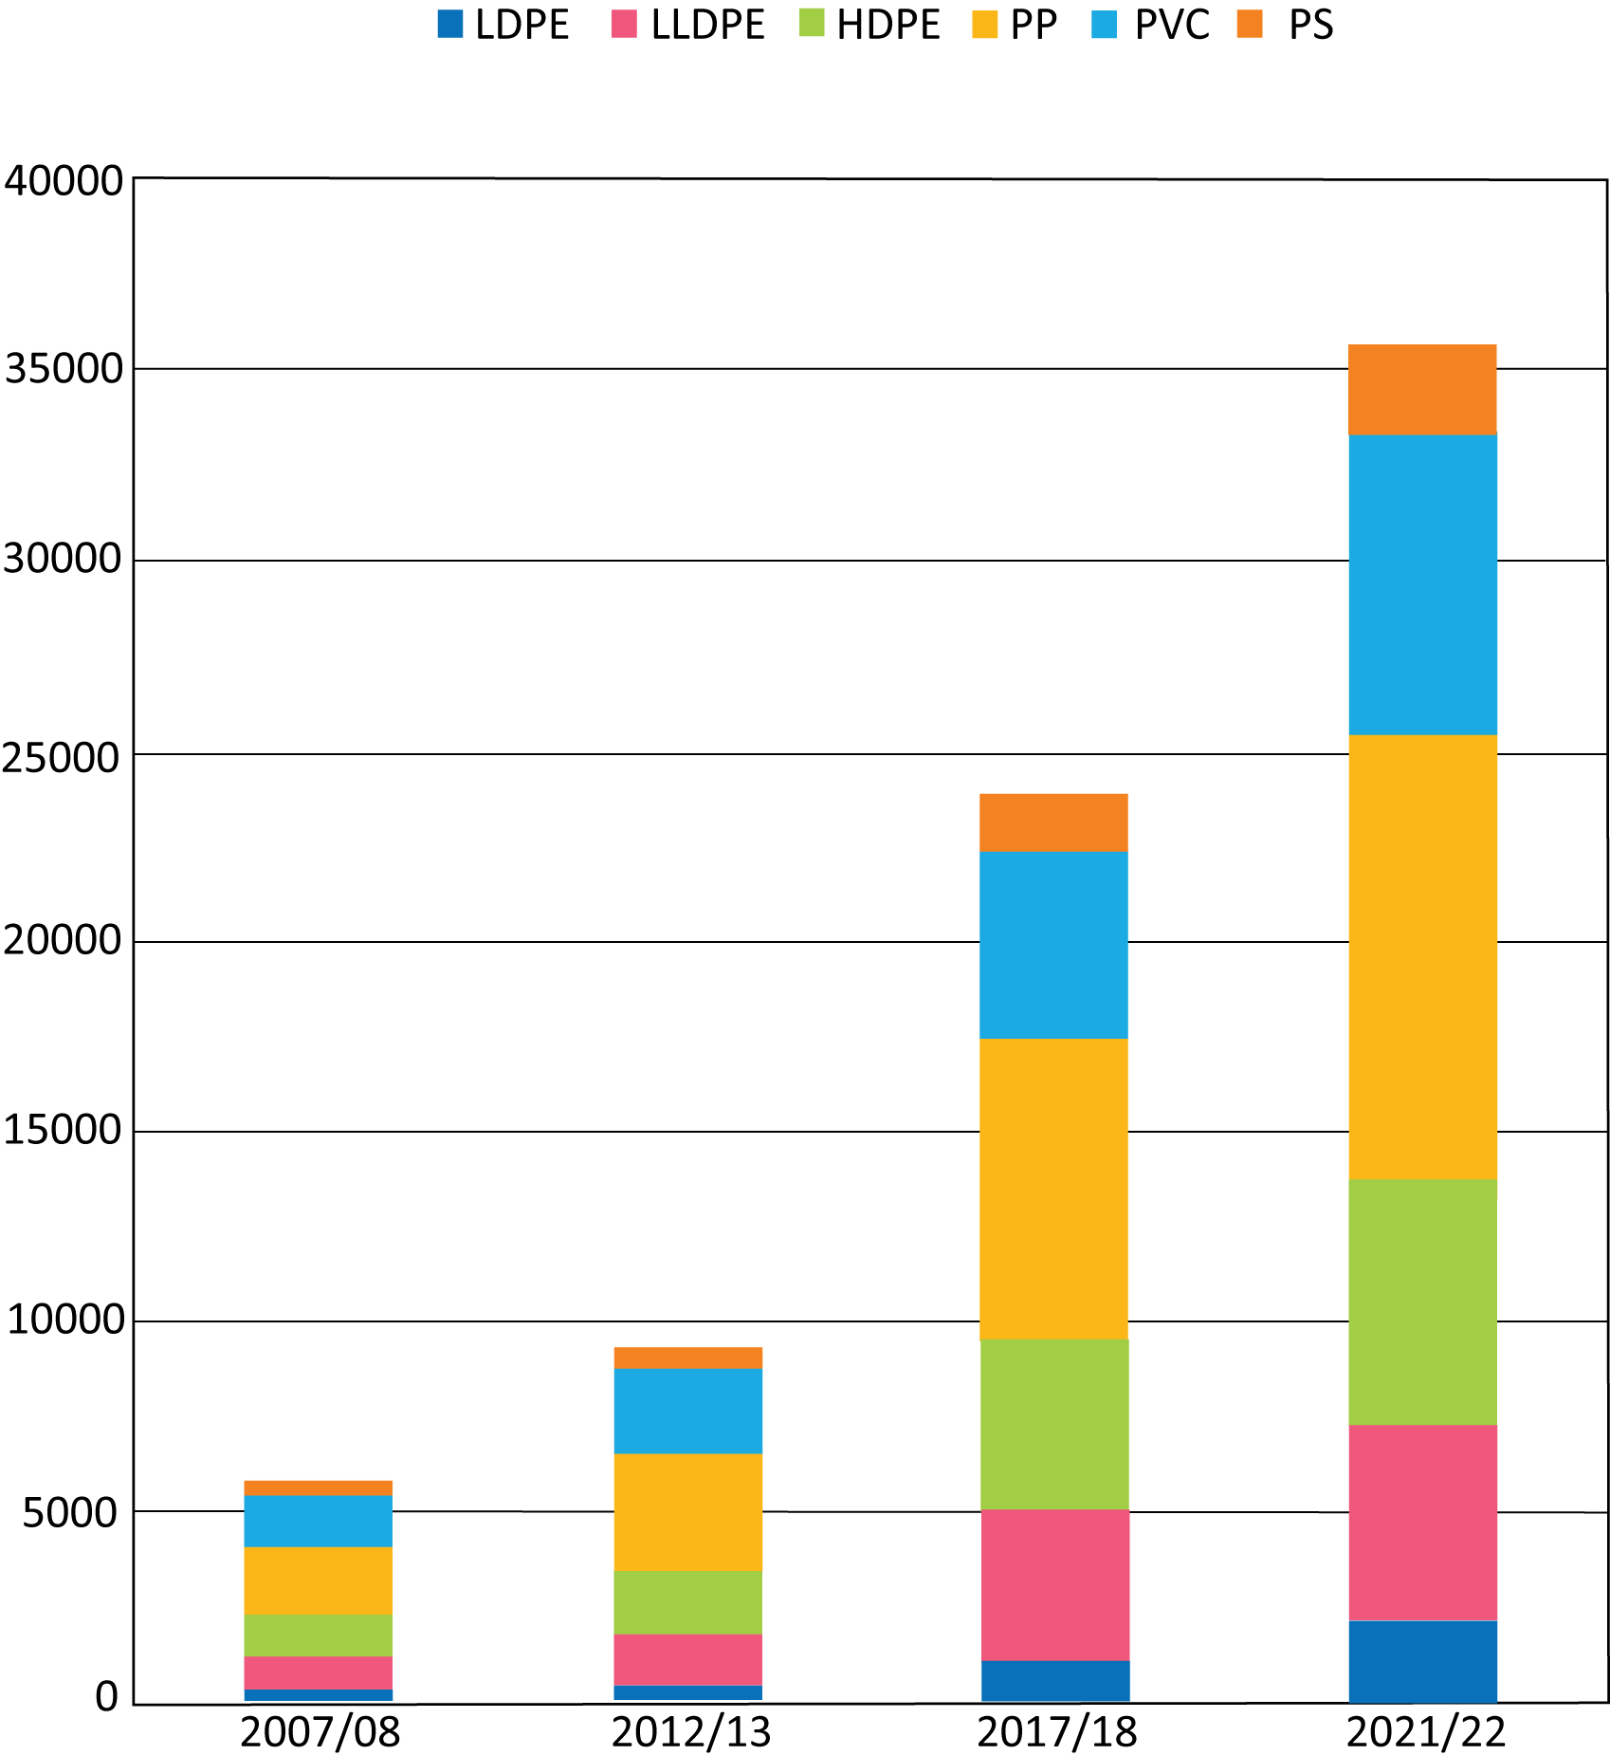
India Polymer Demand:30 million Tonnes by 2021
Polymer Consumption Growth in 2015-16 was 15.0%
Expected to Growth till 2021 at 12.0% CAGR
35000
30000
25000
20000
15000
10000
5000
Source: CPMA

Slide 11
Major Machinery Manufacturers:
Manufacturer | Year of Establishment | Products
Windsor Machinery Limited | 1965 | Extrusion & Injection Molding
Kabra Extrusiontechnik Ltd | 1970 | Extrusion
Lohia Corp Limited | 1975 | Weaving Looms
Rajoo Engineers Limited | 1986 | Extrusion
J.P. Extrusiontech Pvt.Ltd | 1987 | Extrusion
Toshiba Machines Limited (Formerly Larsen & Toubro Machines Limited) | 1992 | Injection Molding
Electronica Plastic machines Limited | 1992 | Injection Molding
Steer Engineering Pvt. Ltd. | 1993 | Compounding Extrusion
Ferromatik Milacron India Pvt. Ltd | 1995 | Injection Molding, Blow Molding & Extrusion
ASB International Pvt. Ltd | 2000 | Blow Molding
Sidel India Pvt. Ltd | 2001 | Blow Molding
Negri Bossi | 2009 | Injection Molding

Slide 12
Global Machinery Manufacturers in India:
Most Global machinery & Auxiliary manufacturers have manufacturing presence in India through fully owned subsidiaries, Joint Ventures or Technology License.

Slide 13
Global Machinery Manufacturers in India:
Countries | Name of Machinery Manufacturers
America | Milacron, Maplan, , Gloucester, Commodore, Brampton
Europe | Battenfeld, Cincinnati, Sidel, Negri Bossi, Penta, Hosokawa Alpine, Bausano, Figli, Ital Tech, Ferromatik, Uniloy, Magplastics, Rollepaal
Japan | Toshiba, Nissei (ASB International)
China | Haitian, Yizumi, JH Welltec
Taiwan | Tedric

Slide 14
Global Auxiliary Manufacturers in India:
Countries | Name of Machinery Manufacturers
America | Nu Vu Conair, Bry Air, Husky, Mold Masters, DME
Europe | Koch Technik, GWK, Wemo, Crizaf, Moditec, Rapid, Wittmann, Motan, Klockner
Japan | Mitsui
Taiwan | Shini

Slide 15
Indian Multinationals in Plastics Machienry:
Countries | Name of Machinery Manufacturers
America | Mamata Machinery
Europe | Windsor Italtech
Patents Held by Indian Machinery Manufacturers
Toshiba: 08 Patents on Injection Molding Machinery
Steer: 12 Patents on Compounding Technology & Machinery
Rajoo: 03 Patents on Thermoforming Machines

Slide 16
Plastics Machinery Growth:
 | 2011-12 | 2012-13 | 2013-14 | 2014-15 | 2015-16 | CAGR %
No of Machines
Domestic Production | 4,200 | 3,250 | 3,650 | 4,200 | 4,900 | 3.9%
Imports | 3,800 | 2,730 | 2,500 | 3,000 | 3,150 | -4.6%
Export | 700 | 500 | 600 | 750 | 750 | 1.7%
India Market | 7,300 | 5,480 | 5,550 | 6,450 | 7,300 | 0.0%
Manufacturing Capacity | 6,000 | 8,000 | 8,000 | 8,000 | 8,000
Value in Rupees Crores
Domestic Production | 2,060 | 1,625 | 1,900 | 2,170 | 2,500 | 5.0%
Imports | 1,940 | 1,400 | 1,400 | 1,420 | 1,620 | -4.4%
Export | 350 | 400 | 500 | 550 | 570 | 13.0%
India Market | 3,650 | 2,625 | 2,800 | 3,040 | 3,550 | -0.7%
Years of low demand
for Capital Goods
Plastics Machinery Growth forecast: 12% CAGR up to 2020-21

Slide 17
Used Machinery Imports
Used Machines are 30% of total Plastics Processing Machinery imports
Used machinery will make Plastics Processors inefficient to face global competition

Slide 18
Plastics Machinery Issues:
Cost Competitiveness:
Machinery uses technology components which are presently imported from Europe, Japan, Korea, Taiwan, which add upto 20-30% of material cost. These imports attract 7.5% customs duty thus inflate the cost. We have represented for duty reduction on these items (one of the officials from Commerce Secretariat said that our request is under consideration).
Used machinery imports to be discouraged:
Advancement in processing machinery for enhancing the energy efficiency and productivity has happened in recent past. Under the compulsions to reduce the carbon footprint processors in the developed world are replacing the older machines with new technology machines. Thus used machinery from developed world is finding a way to developing world with an attractive price tag. Used – aged machinery population if allowed to increase will render the domestic processing industry inefficient to face global competition in long term.

Slide 19
Plastics Machinery Issues:
Need to review the duty structure in FTAs & CEPA:
Duty reductions to 5% for Extrusion and ZERO for IMM in FTAs with South Korea and ASEAN, CEPA with Japan have put domestic machinery at disadvantage on price. Need to review and restore normal customs duties for Plastics machineries.
Skill Development:
Plastics machinery manufacturing is a labor intensive industry, Availability of skill manpower is major issue for Industry. Industry shall form partnership with Academia to facilitate Skill Development amongst operatives, Engineers and Managers.

Slide 20
Plastics Machinery Growth Initiatives (Self & with GOI Support) :
Market Growth:
Preference to Domestic machinery manufacturers in Purchase by PSU and Government institutes.
Development of Supplier Cluster:
Quality and reliability of the product is decided by the quality of components put into its construction and the cost of the product is decided by cost of parts from supplier. Industry needs to pay attention to develop efficient supply chain for cost-quality–delivery leveraging the cluster approach.
Development of Standard for Plastics Machinery :
Standards for bringing uniformity in Specs, performance measurement similar to Euromap for Plastics Machinery
Regulatory standards for Safety , Health and Environment similar to CE, EN 201, ANSI )
Necessary for raising image for participation in Global Market, also for guaranteeing delivery of safe to work with machinery to domestic users

Slide 21
Plastics Machinery Growth Initiatives (Self & with GOI Support) :
Technology Development Fund:
To create technology development fund for processing sector (user industry) for plant modernization with new energy efficient machines. This will help Plastics processors to invest in modern energy saving machines, thus they become competitive in global market. Most of the processors are SME’s
To create technology development fund for Machinery manufacturers for plant modernization with new energy efficient machines.
Government support for participation in International and national Exhibitions
Research & Development with Industry-Academia participation: We need to work on

Slide 22
PMMAI Issues to be Taken up with Inter Ministerial Co-ordination Committee :
Preference to Domestic machinery in procurement by PSU and Government Institutions
Discourage used machinery imports
Customs duty reductions for Technology parts imports [Customs duties were reduced to 2.5% from 7.5% for CNC Systems (HS Code 8537 1000), Ball Screws (HS Code 8483 4000) & Linear Motion Guides (HS Code 8466 9390) for CNC Lathe & Machining center in 2015-16 budget. This duty reduction should be applicable to all machinery types]
Facilitate domestic manufacturing of Technology parts (Servo Motors & Drives, Control, Drive & Motion Elements, Wear Resistant Bushes, Large Castings, Alloy Steel, Lubrication System) by utilizing Sick PSU infrastructure
Plastics & other solid waste recycling machinery needs to be developed
Plastics machinery should be kept in negative list in RCEP negotiations
Revamp the education system/ curriculum – Industry training of 3-6 months is to be made compulsory to ensure students graduating from institutions are near industry ready.

